Slide 1
Essential Question:
How did Jefferson’s presidency change American government, territory, & foreign policy?
Warm-Up Question:
How will the fact that Jefferson was a Democratic-Republican influence his policies as America’s third president?
Notes:
Lesson Plan for

Slide 2
Jefferson as President
As a Democratic-Republican, Jefferson tried to reverse Federalist policies & reduce the size & cost of the national gov’t:
He reduced the size of the army
Cut back Hamilton’s financial plan by ending all excise taxes & allowing the charter of the Bank of the U.S. to expire

Slide 3
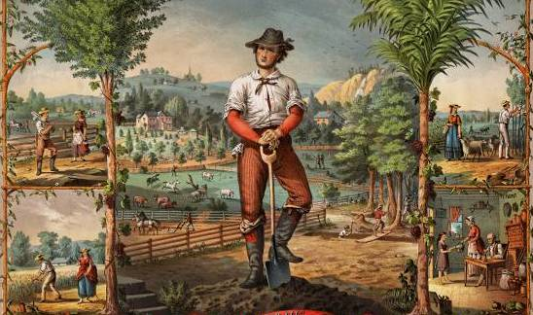
Jefferson believed that America should be an “agrarian republic” that protects liberty

Slide 4
“Midnight Judges”
Before leaving office, President Adams appointed numerous Federalist judges to federal courts
John Marshall became chief justice to the Supreme Court
Over the next 30 years, John Marshall strengthened the power of the national gov’t & the Supreme Court

Slide 5
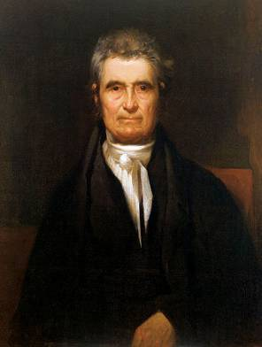
The Legacy of John Marshall
In each of these cases, John Marshall helped strengthen the power of the national gov’t over the states or protected citizens from the power of their state gov’ts
Marbury v. Madison (1803)
McCulloch v. Maryland (1819)
Dartmouth College v. Woodward (1819)
Cohens v. Virginia (1821)
Gibbons v. Ogden (1824)
Cherokee Nation v. Georgia (1831)

Slide 6
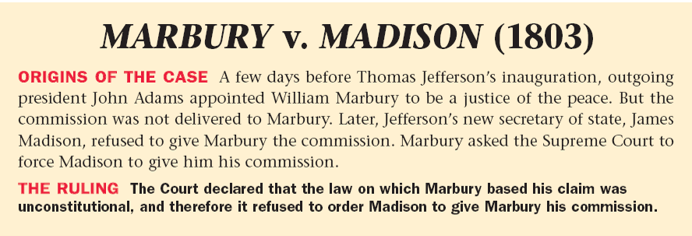
Marbury v. Madison
Jefferson invalidated as many of Adams’ midnight judges as possible
One judge, William Marbury, sued claiming that the president could not overturn an act of Congress
The case Marbury v. Madison (1803) established the principle of judicial review giving the Supreme Court the power to declare acts of Congress unconstitutional

Slide 7
Judicial Review

Slide 8
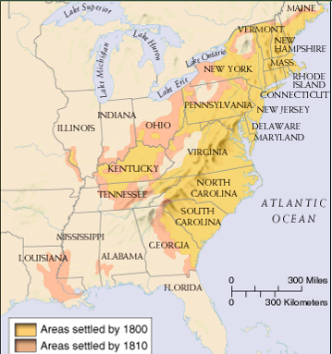
The United States in 1800
From 1800 to 1810, the population grew by 2 million people, thousands flooded into the west, & 3 new states were added to the USA
In 1800, Napoleon reclaimed Louisiana from Spain, but by 1803, he needed money to fund his European war & offered to sell Louisiana
Ohio (1803)
Kentucky (1792)
Tennessee (1796)
Notes:
Americans were flooding into the “west”

Slide 9
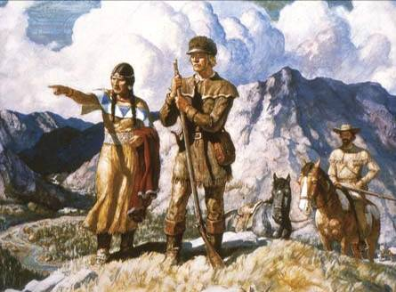
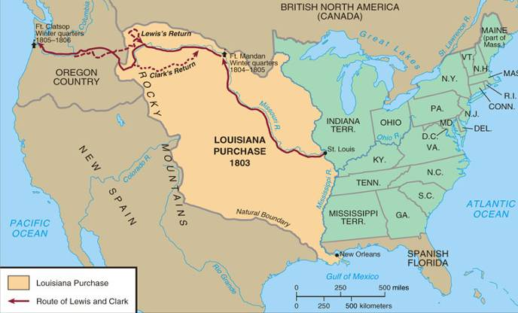
The Louisiana Purchase (1803)
As a “strict constructionist” Jefferson did not know if he had the Constitutional power to buy Louisiana but he did it anyway
In 1803, Jefferson authorized the Louisiana Purchase from France for $15 million
Lewis & Clark were sent by Jefferson to map & explore this new territory; Their findings revealed an abundance of natural resources for America
Notes:
http://www.pbs.org/lewisandclark/trailmap/index.html

Slide 10
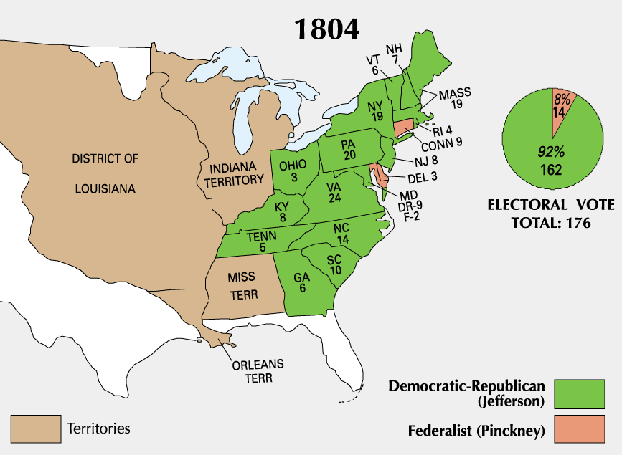
Jefferson easily won re-election in 1804

Slide 11
Jefferson’s Legacy
Jefferson came into office trying to reduce the size & power of the national government, but:
By buying Louisiana, he expanded government power beyond that of the Constitution
He encouraged Congress to create an “embargo” (no trade) to punish England & France for violating U.S. free trade

Slide 12
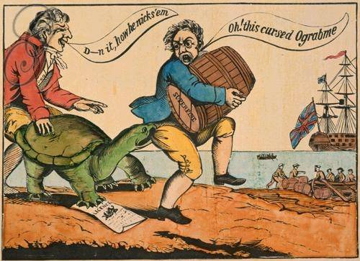
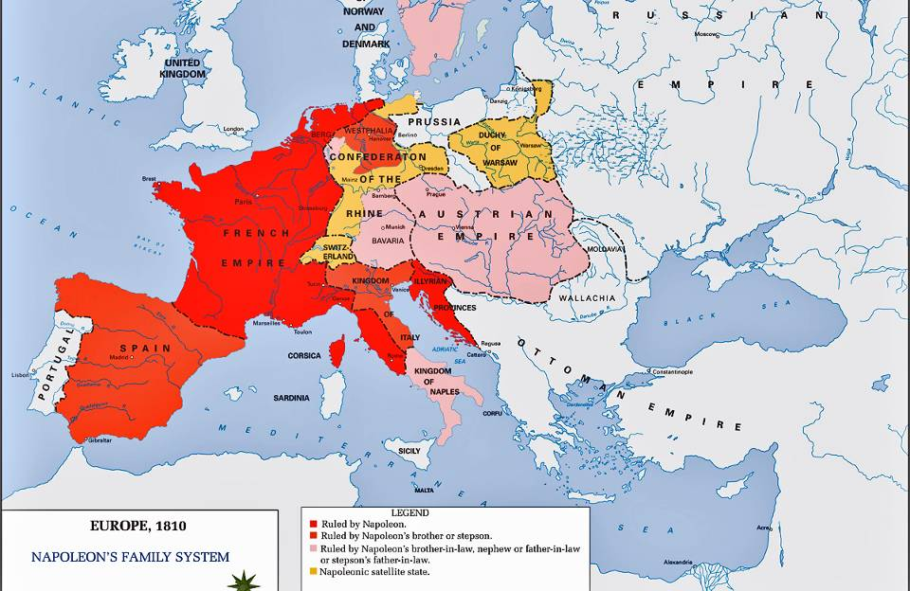
Napoleon’s Empire
Americans smuggled & Jefferson had to increase the size of gov’t to enforce the embargo
Jefferson’s embargo was a “pain in the rear end” because it hurt Americans more than it hurt the English or French

